Slide 1

This Week at Abundant Life
PRAYER REQUESTS
FEATURED ANNOUNCEMENT
• [Newest request] • [Name / request] • [Name / request] • [Name / request] • [Name / request] • [Name / request] • [Name / request] • [Name / request]
Jason Tilley, Senior Pastor
Drop weekly image here
[TITLE] [Date / Time] Paste the main announcement here. This box is for the highest-priority item, event, or ministry emphasis.
[DATE]
We invite you to worship with us today as we give praise and honor to Jesus Christ, our Lord and Savior.
SERVICE TIMES
ANNOUNCEMENTS
Sunday School — 10:00 a.m. Sunday Morning Worship — 11:00 a.m. Children’s Church — 11:30 a.m. Celebrate Recovery — Tuesday 6:00 p.m. Wednesday Night Services — 6:30 p.m.
• [Announcement 1] • [Announcement 2] • [Announcement 3] • [Volunteer need / reminder]
WEEKLY SCRIPTURE / PASTOR NOTE
PRAISE REPORTS
[SCRIPTURE REFERENCE] Paste the weekly verse, short devotion, or pastor note here. Keep this to about 80–120 words for best fit. Pastor Jason Tilley
CHILDREN / YOUTH / MINISTRY UPDATES
• [Praise report] • [Praise report] • [Praise report]
Paste children’s ministry, youth group, Celebrate Recovery, Operation Christmas Child, or volunteer updates here.
Volunteer / Cleaning Need
[Paste volunteer or cleaning reminder here.]
Tip: keep each announcement to 1–2 short lines for readability.

Slide 2


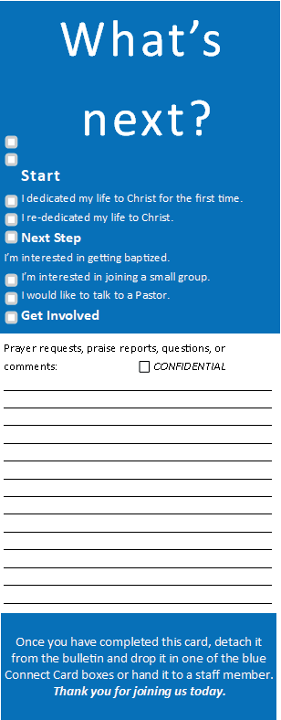
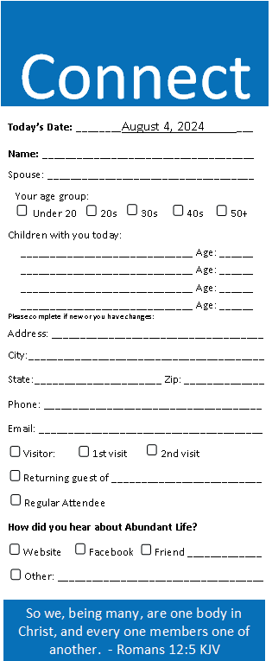

ANNIVERSARIES
BIRTHDAYS
MM/DD - Name & Name MM/DD - Name & Name
MM/DD - Name MM/DD - Name MM/DD - Name MM/DD - Name MM/DD - Name
Drop church photo or seasonal image here
Tithes and Offerings
Need a ride to church?
[DATE] [$ AMOUNT]
Call Lara Fullington 731-217-0139
FUND BALANCES
The life I now live, I live by faith in the Son of God, who loved me and gave Himself for me. — Galatians 2:20
General Fund — $ Building Fund — $ Gravel Fund — $ Emergency Fund — $ Missions Fund 1 — $ Missions Fund 2 — $ Handsful on Purpose — $ Outreach Fund — $ Celebrate Recovery — $ Youth Fund — $ Children’s Fund — $
DON’T FORGET
Please fill out your Connect Card. Let us know that you are here, note prayer requests and praise reports, and tell us if you make a decision for Jesus Christ today. We want to celebrate with you!
179 Old Hwy 22 • Cedar Grove, TN 38321 www.abundantlifefamilyworship.com
[DATE]
Decision / Next Step Reminder
[Short reminder or call to action here.]

